Slide 1
9. Computing ROIs

Slide 2
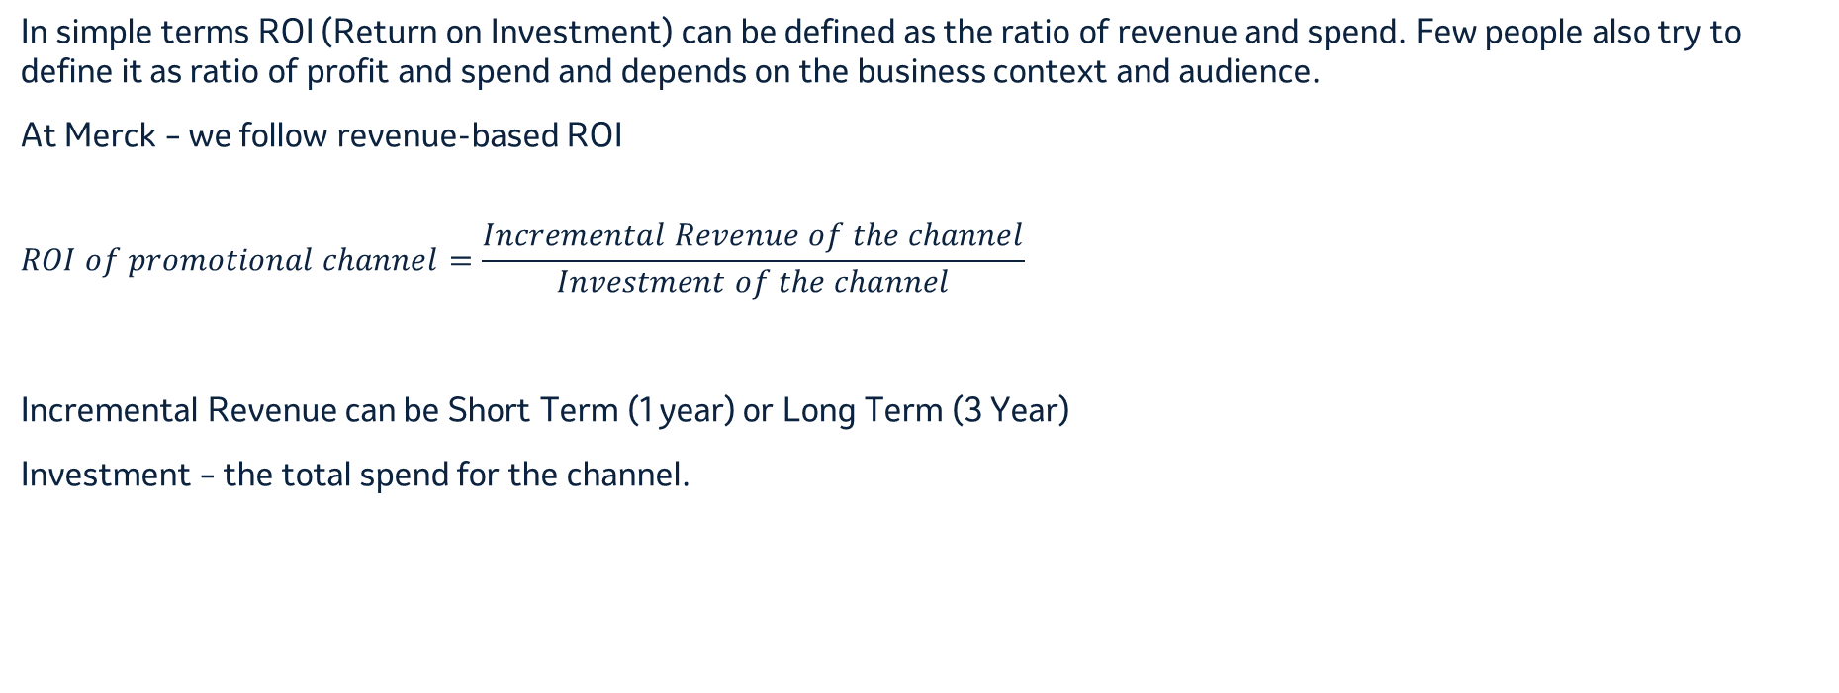
ROI Definition
In simple terms ROI (Return on Investment) can be defined as the ratio of revenue and spend. Few people also try to define it as ratio of profit and spend and depends on the business context and audience.
At Merck – we follow revenue-based ROI
$$ROI of promotional channel=\frac{Incremental Revenue of the channel}{Investment of the channel}$$
Incremental Revenue can be Short Term (1 year) or Long Term (3 Year)
Investment – the total spend for the channel.

Slide 3
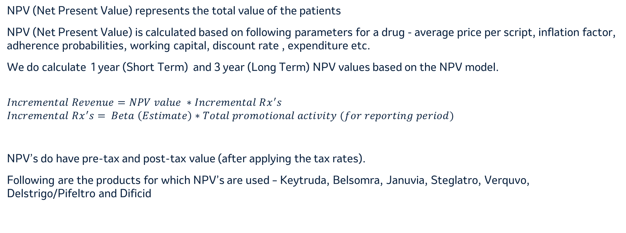
NPV (Net Present Value)
NPV (Net Present Value) represents the total value of the patients
NPV (Net Present Value) is calculated based on following parameters for a drug - average price per script, inflation factor, adherence probabilities, working capital, discount rate , expenditure etc.
We do calculate 1 year (Short Term) and 3 year (Long Term) NPV values based on the NPV model.
$$Incremental Revenue=NPV value ∗Incremental Rx^{′}s$$
$$Incremental Rx^{′}s= Beta \left(Estimate\right)∗Total promotional activity (for reporting period)$$
NPV’s do have pre-tax and post-tax value (after applying the tax rates).
Following are the products for which NPV’s are used – Keytruda, Belsomra, Januvia, Steglatro, Verquvo, Delstrigo/Pifeltro and Dificid

Slide 4
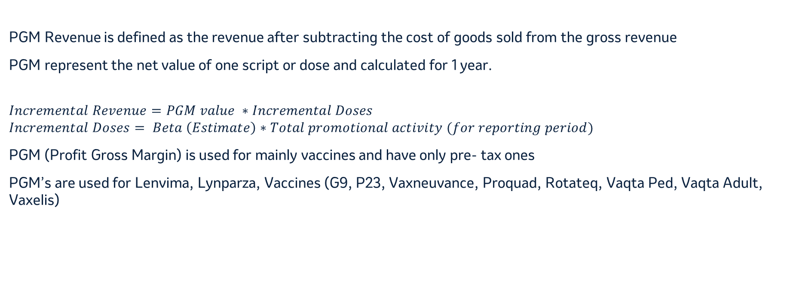
PGM (Profit Gross Margin)
PGM Revenue is defined as the revenue after subtracting the cost of goods sold from the gross revenue
PGM represent the net value of one script or dose and calculated for 1 year.
$$Incremental Revenue=PGM value ∗Incremental Doses$$
$$Incremental Doses= Beta \left(Estimate\right)∗Total promotional activity (for reporting period)$$
PGM (Profit Gross Margin) is used for mainly vaccines and have only pre- tax ones
PGM’s are used for Lenvima, Lynparza, Vaccines (G9, P23, Vaxneuvance, Proquad, Rotateq, Vaqta Ped, Vaqta Adult, Vaxelis)

Slide 5
Output - Estimated pre-tax ROIs and % Contribution for 2023 for G9 Adult
Product | Channel | 2023 pre-tax Spend ($MM) | 2023 Estimated pre-tax Incr. Doses (Beta*Total Activity) | 2023 Estimated Pre-Tax Revenue ($MM) (Incr. Doses * PGM Value) | 2023 Estimated Pre-tax ROI (Revenue/ Spend) | Promotion Efficiency ($Spend/Incr. Dose) | Estimated Contribution to Private Sales (Incr. Doses/Total Private Doses) | Marginal ROI (Incr. Rev/Incr. spend)
Gardasil Adults | HCC InOffice | $1.1 | 7,368 | $2 | 1.5 | $154 | 0.16% | 1.0
Gardasil Adults | HCP MCM | $10.5 | 288,339 | $65 | 6.2 | $36 | 6.20% | 4.9
Gardasil Adults | HCC Social | $1.8 | 23,820 | $5 | 3.1 | $74 | 0.51% | 1.8
Gardasil Adults | HCC Online Video | $1.1 | 21,646 | $5 | 4.4 | $51 | 0.47% | 3.1
Gardasil Adults | HCC Streaming Video | $13.4 | 100,808 | $23 | 1.7 | $133 | 2.17% | 1.2
Gardasil Adults | HCC Display | $2.9 | 76,065 | $17 | 6.0 | $38 | 1.64% | 3.6
Gardasil Adults | HCC Paid Search | $0.1 | 30,137 | $7 | 136.2 | $2 | 0.65% | 84.0
Gardasil Adults | HCC Radio | $0.9 | 26,582 | $6 | 6.5 | $35 | 0.57% | 2.7
Gardasil Adults | HCC Linear TV | $25.8 | 168,508 | $38 | 1.5 | $153 | 3.63% | 1.0
Gardasil Adults | HCC Pharmacy | $2.4 | 18,206 | $4 | 1.7 | $132 | 0.39% | 1.3
Gardasil | Total | $60.0 | 761,479 | $172 | 2.9 | $79 | 16.38%

Slide 6
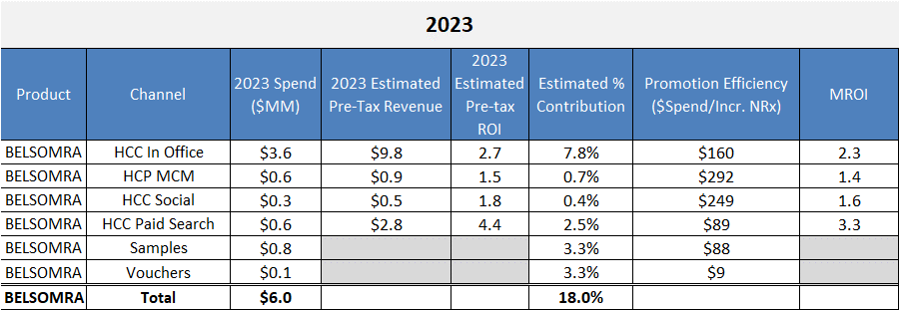
- Estimated pre-tax ROIs and % Contribution for 2023 (Belsomra)

